Slide 1
Introduction to ML
Aiden Tepper
Informatics Skunkworks (MSE 299), 2 Credits
02-15-2021

Slide 2
Hours Summary
Date | Hours | Description of Work
2/15/21 | 3 | Worked through sections 1-3
2/16/21 | 3 | Worked through sections 4-7 and made slide deck

Slide 3
Progress
The task assigned this week was to work through the Introduction to Machine Learning Jupyter notebook
There were 7 sections that walked us through creating, training, testing, and optimizing a machine learning model to predict the bandgap of different materials
The best way to represent results from this week’s tasks is through the results from running snippets of code on the notebook, in the form of either tables or charts/graphs

Slide 4
Problems
Towards the beginning of the notebook, I experienced some slight difficulties with the learning curve for figuring out how to navigate and run Jupyter notebooks, as the software was new to me
The solution was to take it slow and go through the tutorial/instructions to get a solid grasp of how to navigate the page
I did not encounter any issues with the execution of code, but at times struggled with understanding the concepts I was working with
The solution to this challenge was to read through each section carefully to make sure there were no gaps in my knowledge so I didn’t get lost later on in the notebook

Slide 5
Questions
Nothing about the procedure was specifically confusing to me
However, I would like to go over either in small groups or as a whole a couple steps of the procedure to make sure I fully understand what was going on behind the scenes during certain steps
I would especially like to focus on sections 6 and 7, as I got a little confused once we started optimizing the parameters and hyperparameters of the machine learning model

Slide 6
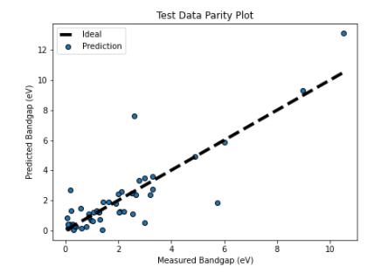
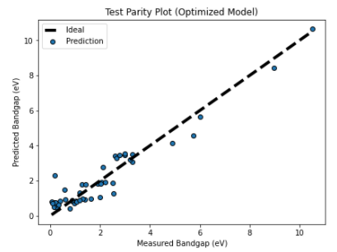
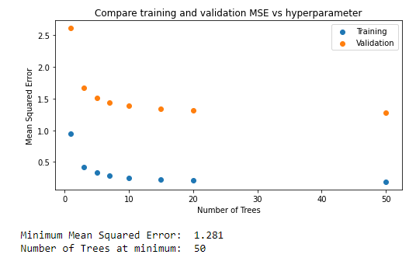
Assessment Figures

